Slide 1

Recitation 3 /////

Slide 2
Announcements
Programming Exercise 2 due Thursday (09/09)
Programming Exercise 3 released Friday (09/10) and due next Thursday (09/16)

Slide 3
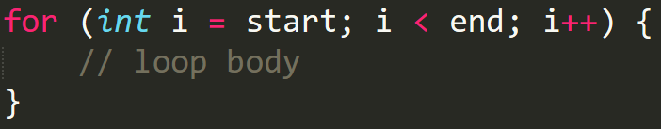
Pre-Quiz
1. (T/F) In Java, if you have an if block, it must be followed by an else block.
2. What is the value of myNum after the code executes?
int myNum = (7 + 3 == 12) ? 1 : 0;
3. In Java, what three elements are required for a for loop?
4. Convert the following for loop to a while loop:
5. (T/F) If an 'if' block executes, the 'else if' and 'else' blocks will also execute.
6. Evaluate the following Boolean expressions:
T || (F && T)
T && (F || (T && !F))

Slide 4
Pre-Quiz
1. (T/F) In Java, if you have an if block, it must be followed by an else block.
2. What is the value of myNum after the code executes?
int myNum = (7 + 3 == 12) ? 1 : 0;
3. In Java, what three elements are required for a for loop?
4. Convert the following for loop to a while loop:
5. (T/F) If an 'if' block executes, the 'else if' and 'else' blocks will also execute.
6. Evaluate the following Boolean expressions:
T || (F && T)
T && (F || (T && !F))
False
0
Initializer, Condition, Update
int start;
int end;
while (start < end) {
start++;
}
False
True
True

Slide 5
Topic List
Boolean Expressions
Conditionals (if, else if, else, ternary, switch)
Iteration (while loops / for loops)

Slide 6
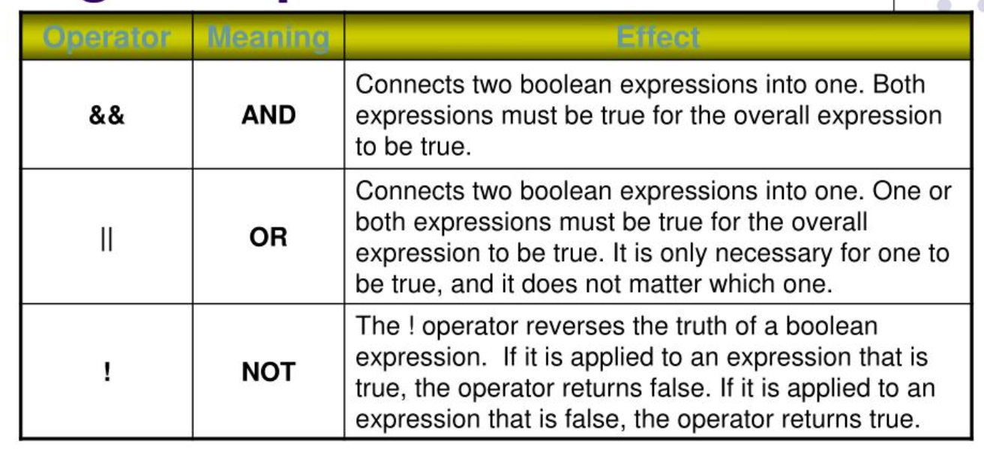
Boolean Expressions: Logical Operators

Slide 7
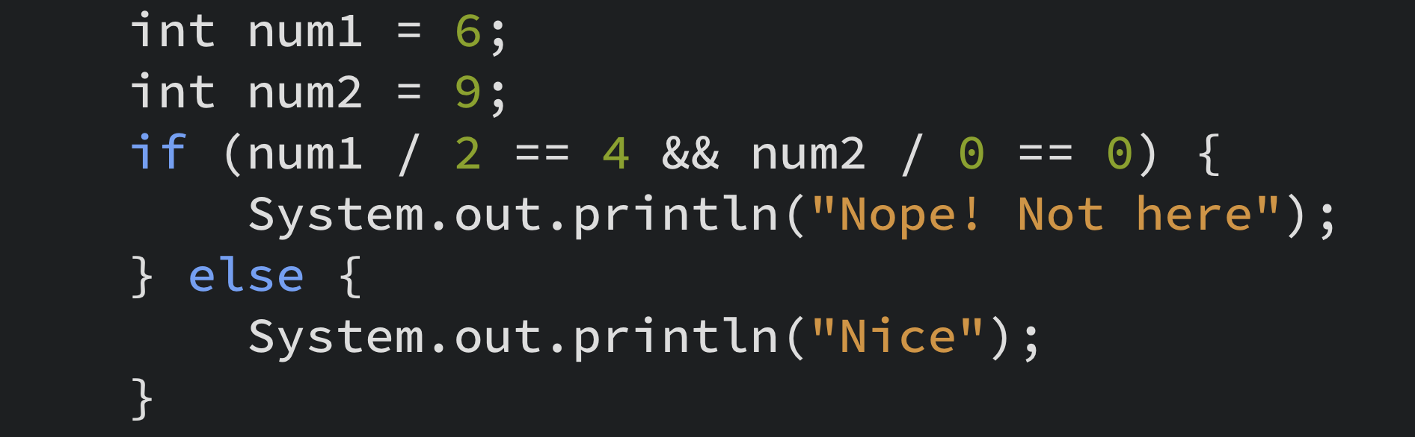
Short-Circuit Evaluation
It happens because the result of a logical expression is clear before its complete evaluation.
Avoids unnecessary work and leads to more efficient processing.
AND (&&) operator: The expression is evaluated until we get one false result.
OR (||) operator: The expression is evaluated until we get one true result.

Slide 8
Conditionals: If / Else Statement
Use if to detail a block of code to be executed, if the specified condition is true
Use else if to detail a block of code to be executed, if the first condition is false and the specified condition is true.
Use else to detail a block of code to be executed, if the same condition is false for all above cases.
Remember else and else if are optional!

Slide 9
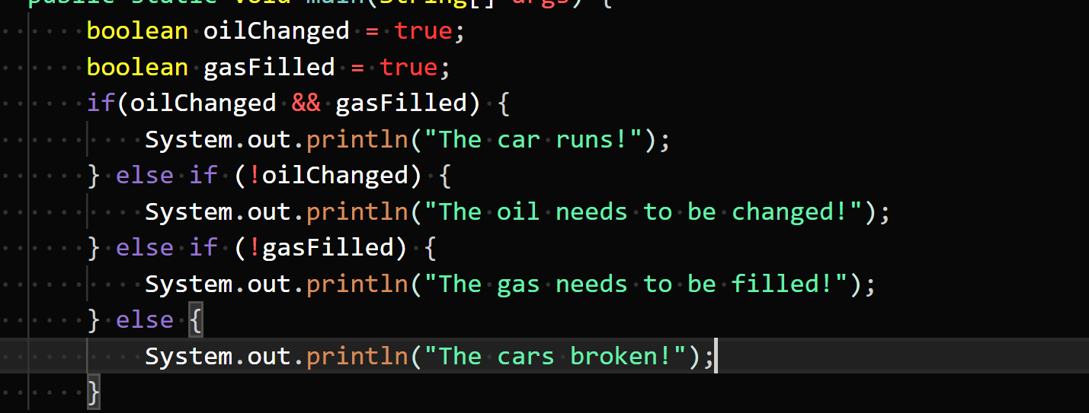
A Quick Example...

Slide 10
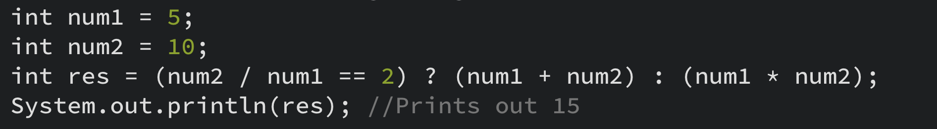
Ternary Operator
Simplified way to write if – else statements.
Syntax: variable = expression1 ? expression2 : expression3;
If expression1 is true, then expression2 is executed.
If expression1 is false, then expression3 is executed.
The resulting value of the expression that is executed gets assigned to variable.

Slide 11
Conditionals: Switch Case Statements
A great way to handle conditionals when choosing between many discrete values.
One case statement for each of the possible values the variable can take.
The default statement is optional and will only be used if none of the previous cases were true.
Always put a break statement after each case to avoid fall through!

Slide 12
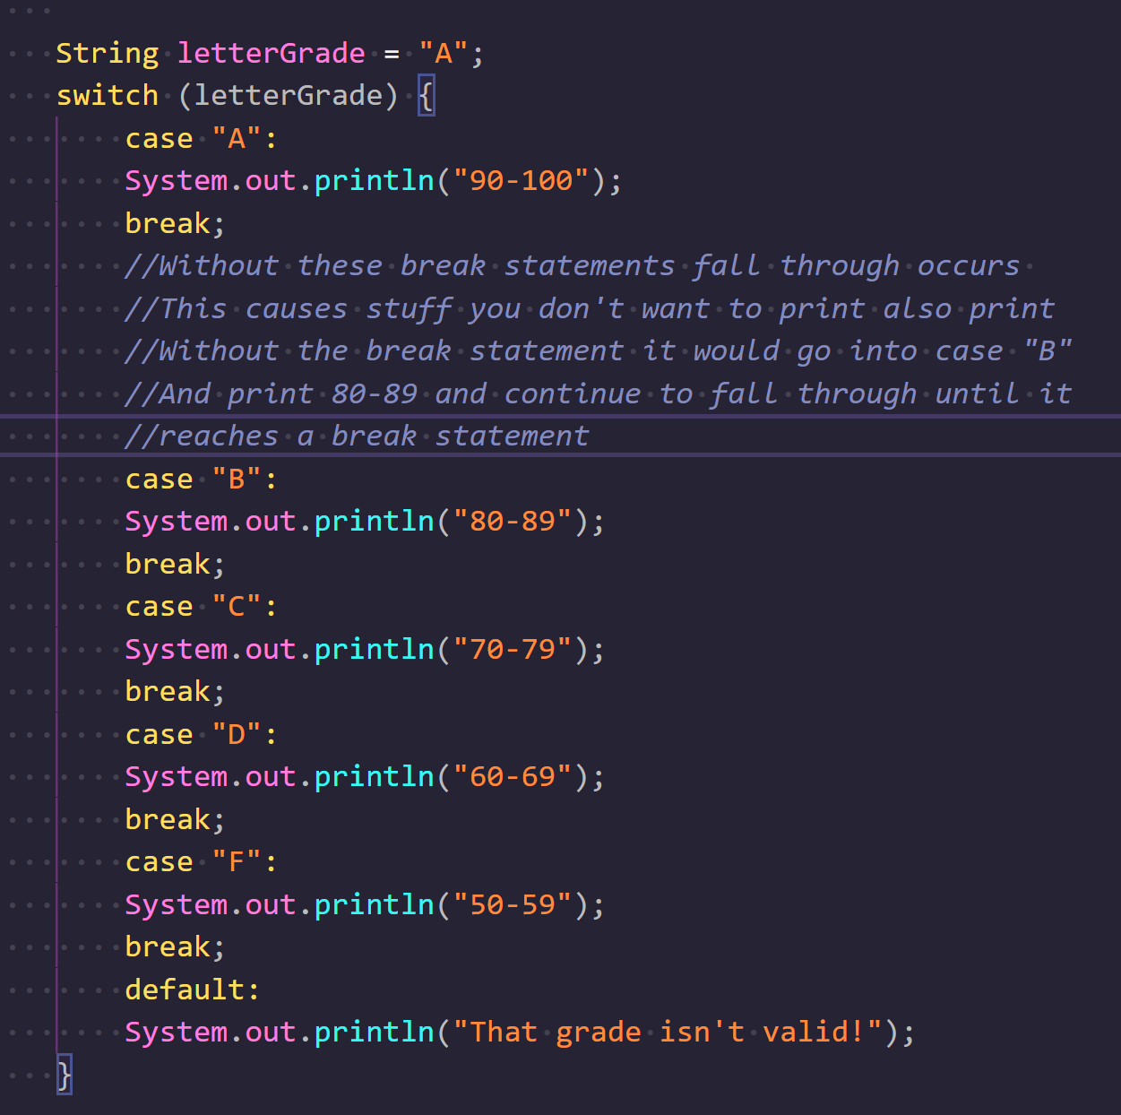
A Quick Example...

Slide 13

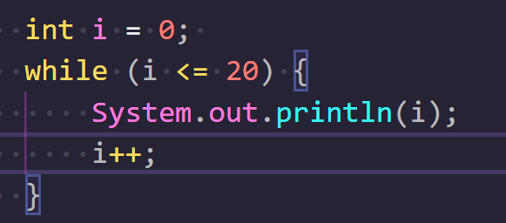
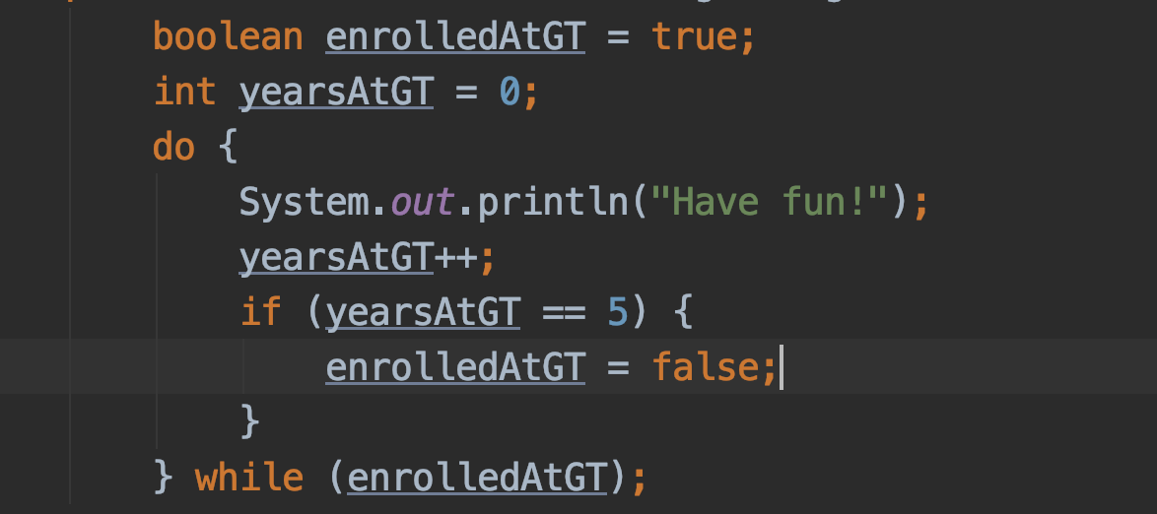
Loops

Slide 14
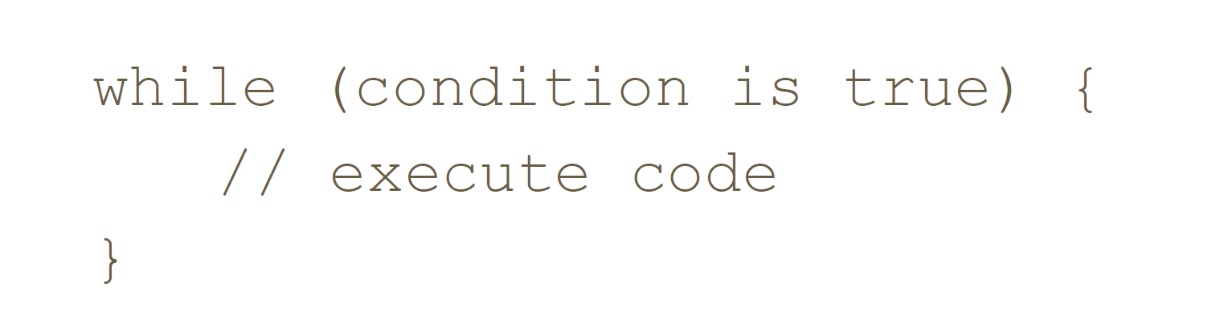
While Loops
While loops execute as long as the conditional statement is still true.
The conditional statement is evaluated before beginning the loop.
Keep in mind to make the conditional statement false at some point for the loop to end. You don't want to end up with an infinite loop!
Tip: Use it when you don't know exactly how many times the code will repeat.

Slide 15
Do - While Loops
Very similar to while loops in concept.
The conditional statement is evaluated after the loop.
Again, keep in mind to make the conditional statement false at some point.
Tip: Use it when you always want to execute a certain block of code at least once.
do {
//Execute code
} while (condition is true);

Slide 16
For Loops
For loops have 3 components: initializer, condition, update.
The initializer is always executed once
The condition is checked before each iteration (including the first iteration).
The update is executed after each iteration.
For loops can be transformed into while loops and vice versa.
Tip: Use it when you know exactly how many times the code will repeat.

Slide 17
Coding Activity
TAs will now take you through a coding activity!

